Slide 1
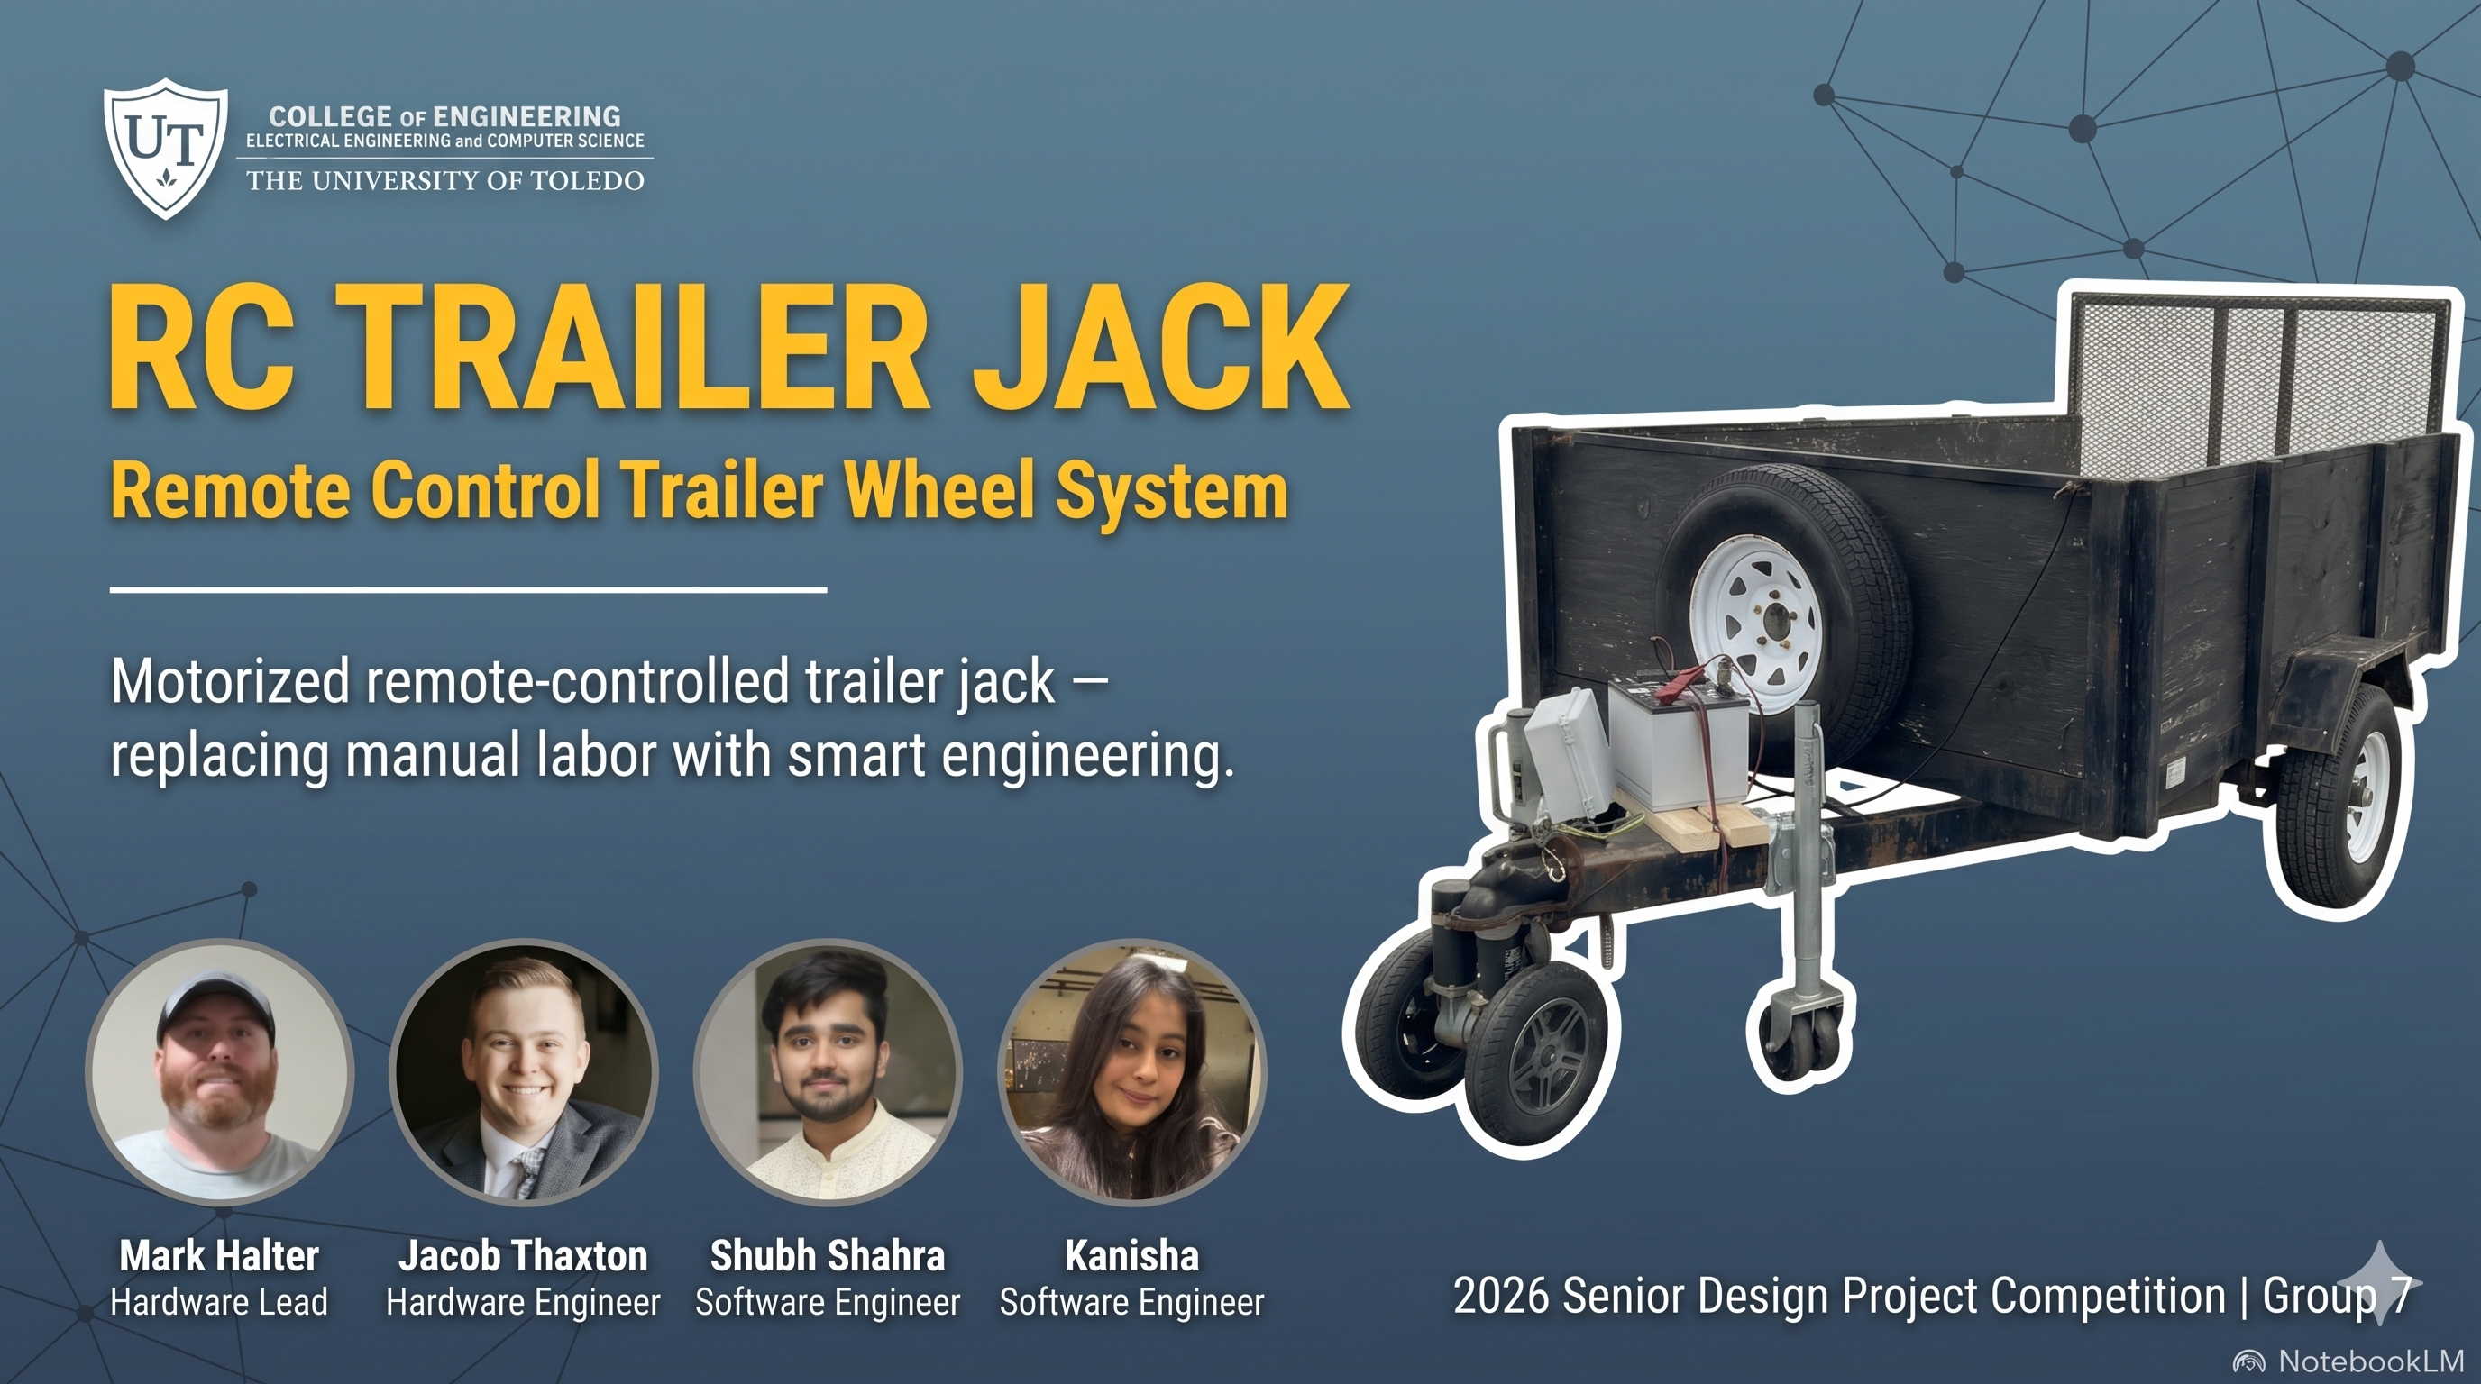




Slide 2
Need Statement
Problem: Trailer owners often struggle with manual parking, positioning, and connecting to their trailers. Environmental factors often limit vehicle maneuverability, adding to the difficulty.
Solution: Construct a remotely controlled, electronically driven trailer jack to reduce physical effort, improve parking availability, and decrease trailer collisions during parking and hitching.

Slide 3
Engineering Targets
Continuous duty cycle of 10mins
Power Requirement = 12 V
Wireless control range of ≥ 30ft
Can Move a Tongue Load of 500 lbs
Movement Speed = 1 mph

Slide 4
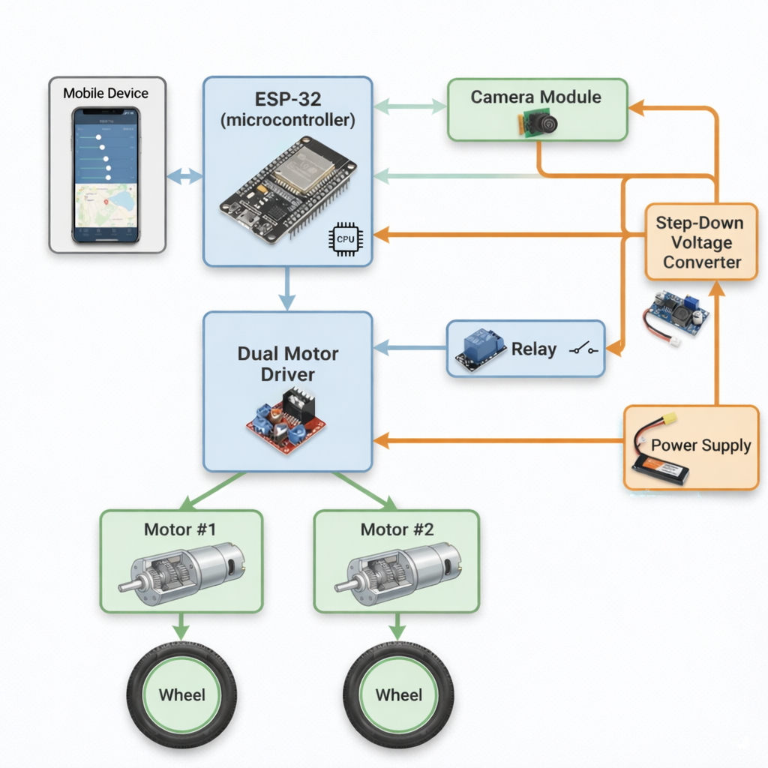
Diagram of Components

Slide 5
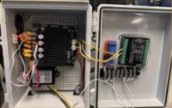
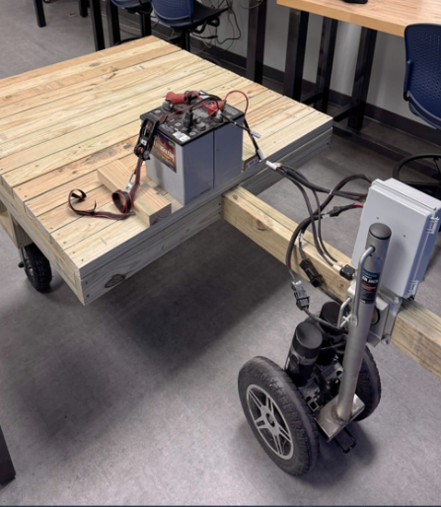
Hardware Decisions
HAUL-MASTER 1000lb Capacity Swing Away Trailer Jack
Standard Connection
Meets weight requirement
CM808-029F/E Motors
Provides necessary power
P = F x v
F = Crr x W
Corrects for inefficiencies, startups, and small inclines
Bearings and wheels capable of weight requirement
2 x 12V Deep Cycle Batteries (In series providing 24VDC)
Obtained with motors for good price
Exceeds Runtime Requirements (could run at rated peak for 1 hour)
ESP32 Microcontroller
Offered Real-Time Control Capability
Flexible I/O (for PWM and Digital)
Additional Components
Weatherproof Enclosure
Wood
Rigid Casters
Relay
Power Distribution Block
Step Down Voltage Converter

Slide 6
Software Design: Dual ESP32 Control System
Motor ESP32 — BLE Control
Camera ESP32 — Wi-Fi Video
Receives commands from Android app
Controls steering, throttle, gear, brake
Sends PWM to dual motor drivers
Emergency stop and watchdog
Creates BackCam hotspot
Streams at 192.168.4.1:81
Separate from motor control
Reduces processing delay
Both systems operate independently to ensure responsive motor control while maintaining smooth video streaming for real-time trailer positioning.

Slide 7
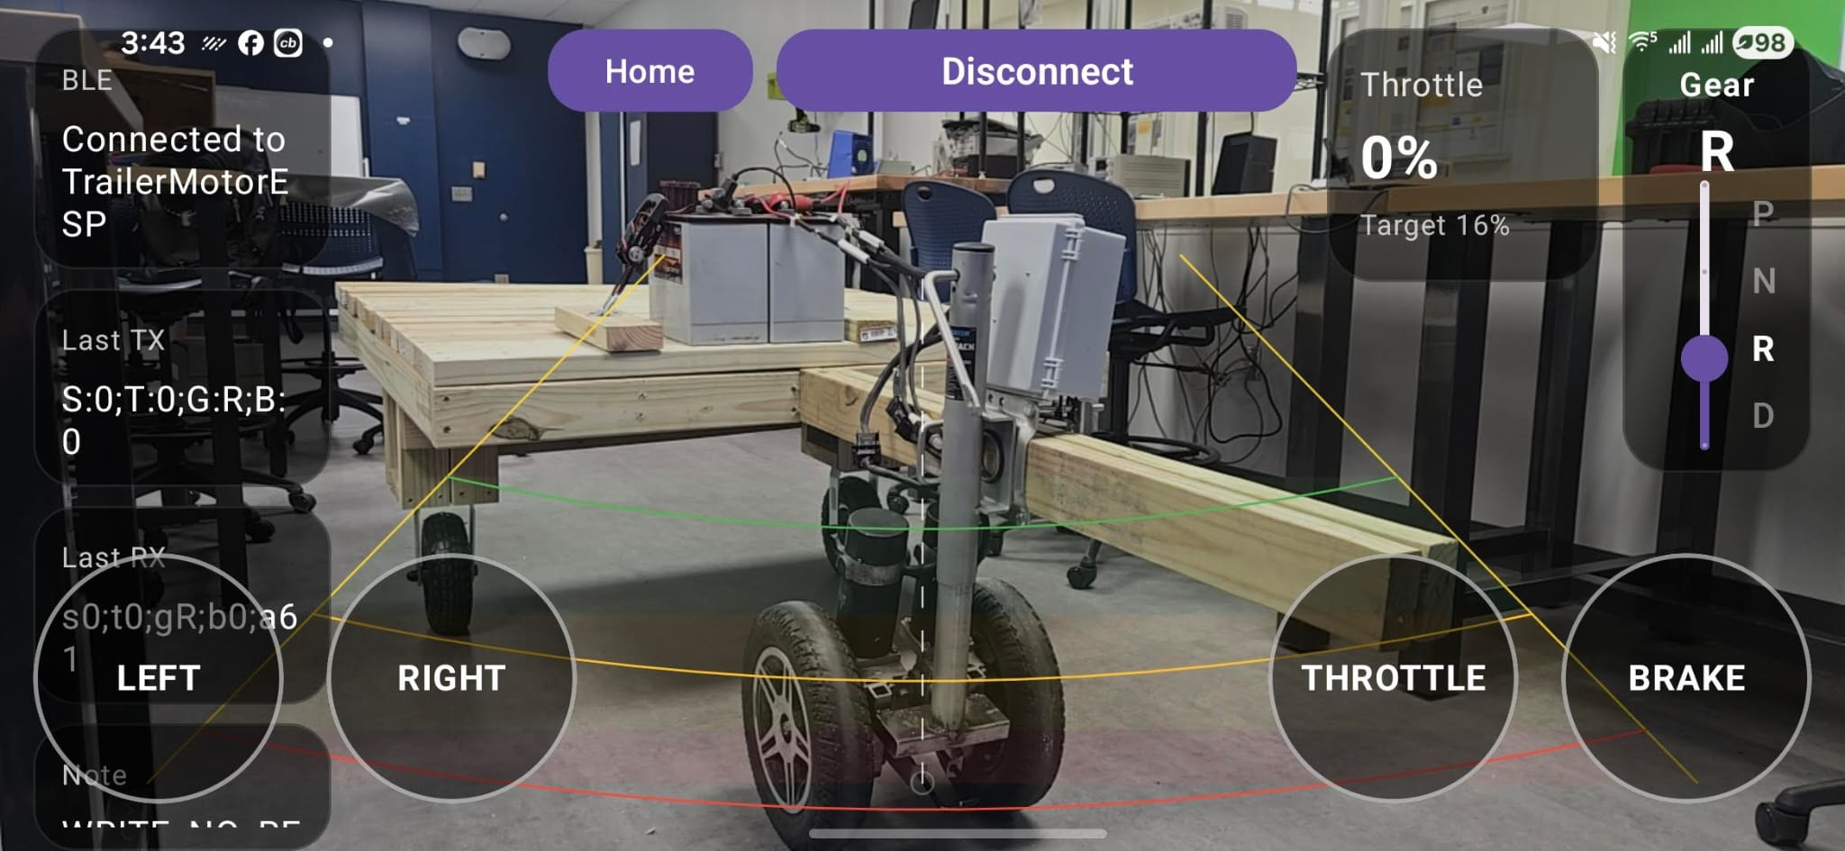
Mobile App Interface: Real-Time Trailer Control
Kotlin Android app used as the main controller
Sends control commands for steering, throttle, brake, and gear
Includes P / N / R / D gear selector
Displays connection status, last TX, and last RX packets
Uses hold-to-drive buttons for safer movement
It provide Ramp up and Ramp down.
Sends communication signal every 200 msec as ESP-32 has a watchdog of 500 msec.

Slide 8
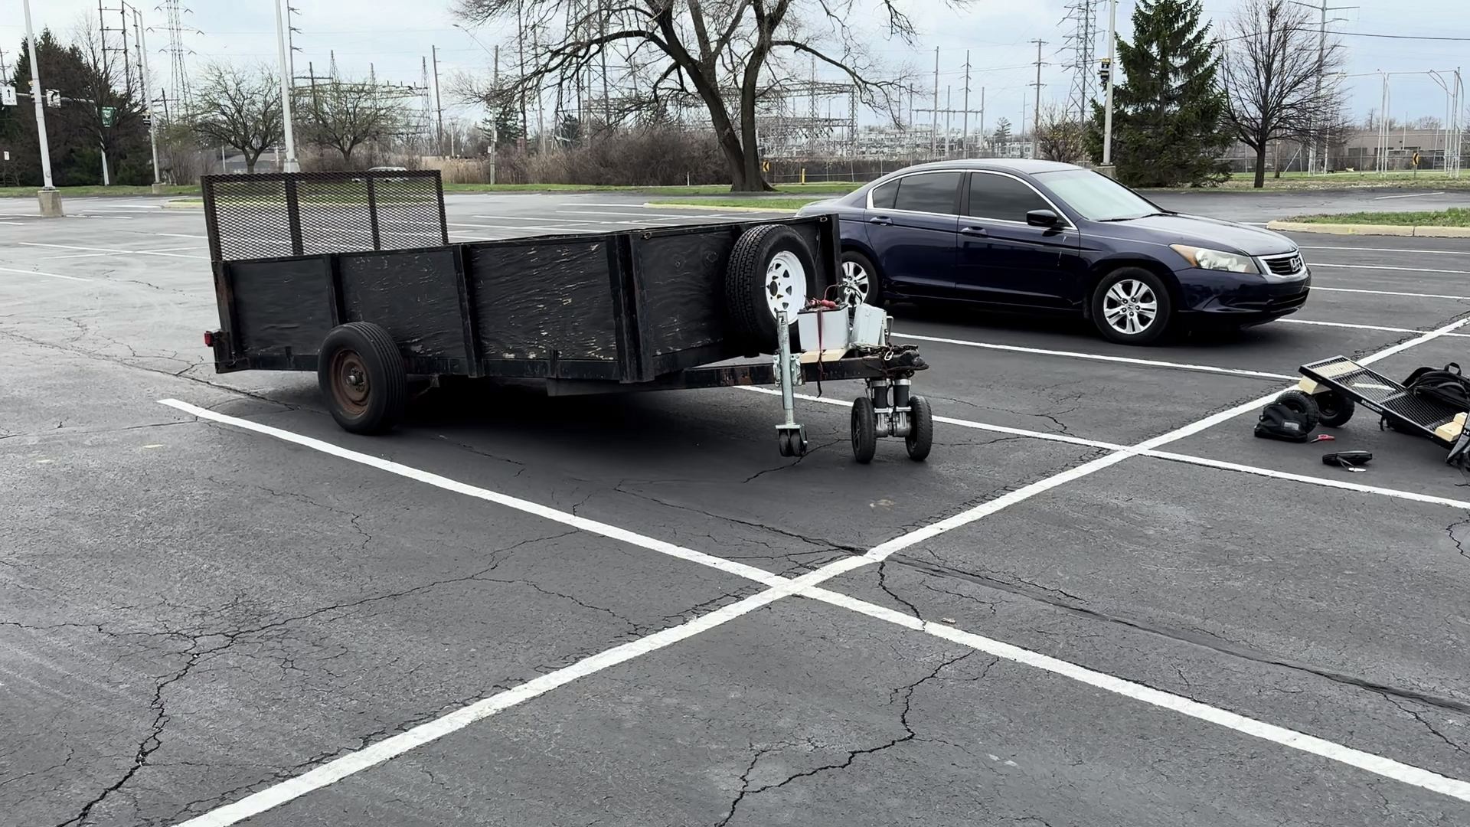

Slide 9
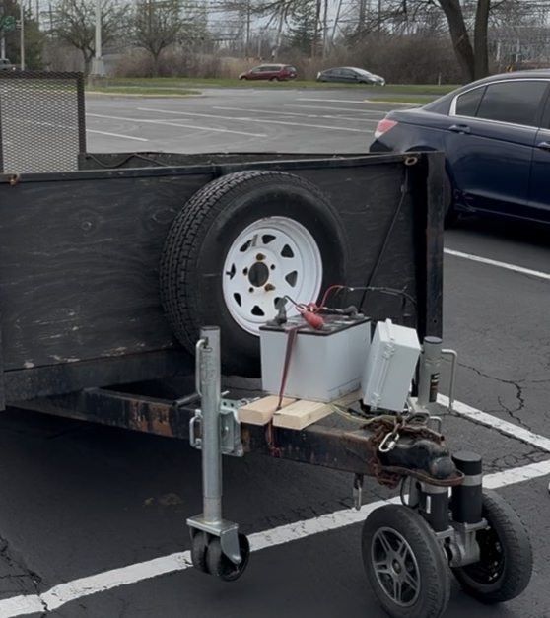
Testing Results
✔️ Successful test on full-scale trailer
Tested with ~600 lbs load and trailer weight
Limited mobility due to incorrect trailer type
✔️ Successful test on mock trailer
Tested with ~200 lbs load and trailer weight
Full mobility

Slide 10
Target Evaluation
Control Range ≥ 30ft
Load of 500 lbs
Movement Speed = 1 mph
Power Supply 24 V
Duty Cycle > 10mins

Slide 11
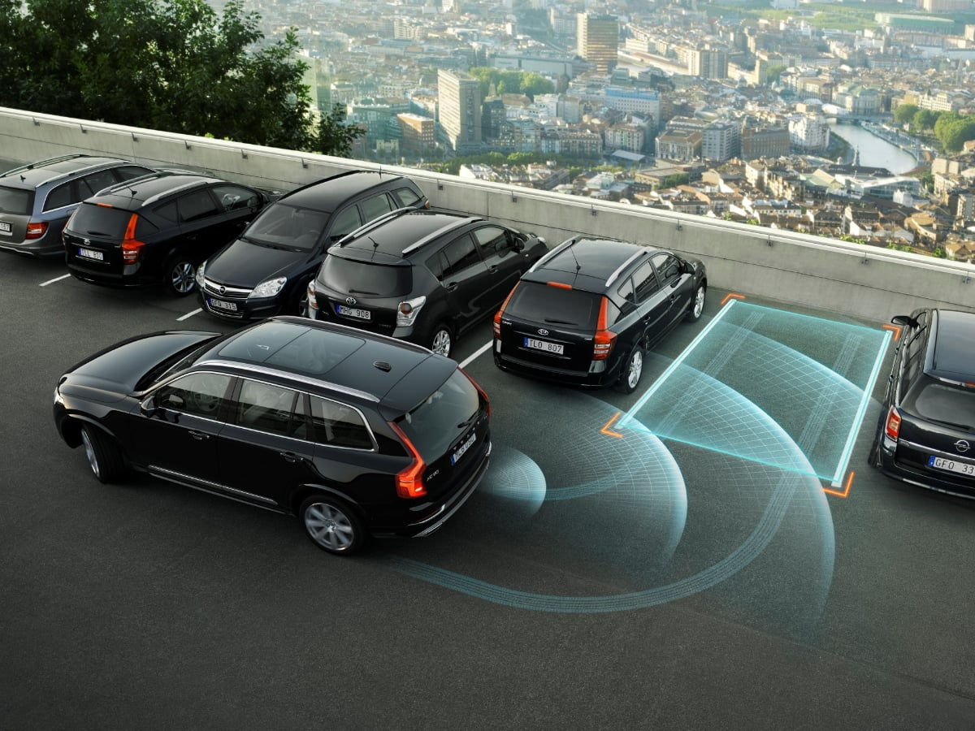
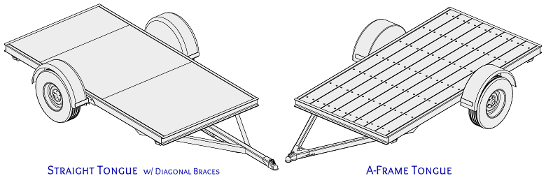
Future Improvements
Self-Parking
Automated set-up for hitching
Compatibility with multiple trailer styles
Reduce battery size
Reduce size and/or improve placement of motors

Slide 12
References
Cytron Technologies. (n.d.). SmartDriveDuo Arduino examples. GitHub. https://github.com/CytronTechnologies/Cytron_SmartDriveDuo/tree/master/examples
Espressif Systems. (n.d.). CameraWebServer example for ESP32 Arduino core. GitHub. https://github.com/espressif/arduino-esp32/blob/master/libraries/ESP32/examples/Camera/CameraWebServer/CameraWebServer.ino

Slide 13

Thank you!
Any Questions?

